Slide 1

FINAL YEAR RESEARCH PROJECT
Review-1 Presentation [AI BASED EARLY DISEASE RISK PREDICTION SYSTEM USING MACHINE LEARNING]
Supervised By: Dr. Bhanu Pratap Rajak
Group No.: 04
Priyansu Nayak – 2241014108
Subhojeet Sarkar – 2241019321
Himanshu Sekhar Dash – 2241014163
Pikesh Yadav - 2241025009
Department of Computer Sc. and Engineering
Faculty of Engineering & Technology (ITER)
Siksha ‘O’ Anusandhan (Deemed to be) University
Bhubaneswar, Odisha
1

Slide 2
Presentation Outline
Problem Statement & Motivations
Problem Statement
Motivations
Literature Review
Existing Solutions & Limitations
Proposed Methodology & Approach
Key Components/Modules & Algorithms Used
Dataset & Tools/Technologies
Work Done So Far (Implementation Progress)
Preliminary Results (if any)
Future Work Plan
References
2

Slide 3
Problem Statement
Domain : Healthcare Analytics & Machine Learning
Problem Statement :
Chronic diseases such as diabetes and heart disease often remain undetected until advanced stages.
Traditional diagnosis depends on periodic medical tests and lacks continuous monitoring.
There is a need for a data-driven system that can predict disease risk early using patient health indicators.
3

Slide 4
Motivations
Need for a unified system that can predict multiple diseases at an early stage
Helps individuals and healthcare providers in making timely decisions
Enables preventive healthcare instead of late diagnosis
Bridge gap between ML models and real-world usability via web interface
4

Slide 5
Literature Review
Table 1:Summary of Existing Approaches and Research Limitations
[Example Table for Reference]
S. No. | Author & Year | Methods/Techniques Used | Dataset Used | Research Outcomes | Findings | Link
1 | Gupta, V. (2025) | Decision Trees, Random Forest, ANN, XGBoost for early‑detection of diabetes and heart disease. | Pima‑like diabetes and UCI‑style heart‑disease datasets. | Accuracy >85% with strong F1‑score; good early‑detection performance. | Strong for early‑stage prediction, but disease‑specific and no preventive‑focused UI. | https://ijrti.org/papers/IJRTI2507002.pdf
2 | Pandey & Gautam (2024) | Multiple ML models (including Random Forest) for heart‑disease risk in diabetic patients. | Longitudinal cohort of diabetic patients (up to 9‑year follow‑up). | Model showed modest but meaningful early‑risk signals. | Only moderate AUC and no explicit risk‑level interface for community screening. | https://pmc.ncbi.nlm.nih.gov/articles/PMC12972564/
3 | Kanda et al. (2022) | XGBoost for CKD and heart failure risk in early‑stage T2DM. | Large Japanese claims‑based cohort (217,054 T2DM patients). | XGBoost AUC ≈0.718–0.837, outperforming simpler models. | Heavy, data‑intensive; not suitable for low‑resource primary‑care. | https://www.nature.com/articles/s41598-022-24562-2
4 | Zhang & Liu (2026) | Logistic Regression, Random Forest, K‑NN, SVM, Decision Tree, Naïve Bayes for diabetes risk. | Pima‑like diabetes dataset (768 instances, 9 features). | RF and DT ≈100% training accuracy; others ≈77–81%. | High performance on small‑scale data but limited real‑world generalization. | https://healthcare-bulletin.co.uk/article/risk-of-diabetes-disease-prediction-using-machine-learning-approach-2596/
5 | Ooko & Oginga (2025) | Neural Network optimized for early‑stage chronic disease (diabetes, CVD, CKD) in Africa. | African cohort data. | NN ≈89% accuracy; suitable for edge‑based preventive screening. | Region‑specific data and weak interpretability for clinicians. | https://pmc.ncbi.nlm.nih.gov/articles/PMC12437260/
5

Slide 6
Research Gap & Improvements
Research Gap :
Most existing systems focus on single-disease prediction rather than a unified approach
Heavy dependence on complex or region-specific datasets, limiting general usability
Lack of clear risk categorization (Low / Medium / High)
Limited availability of deployable, user-friendly interfaces
Many models report high accuracy but lack real-world integration and usability
6

Slide 7
Research Gap & Improvements
Improvements :
Developed a multi-disease prediction system (Diabetes, Heart, Lung) in a single platform
Implemented threshold-based risk classification (Low / Medium / High) instead of raw outputs
Applied feature selection + preprocessing pipelines for better performance
Implement and compare ML models: Logistic Regression, Random Forest, SVM, XGBoost
Perform comparative analysis to select the best-performing model
Build a lightweight Streamlit web interface for real-time user input and risk prediction

Slide 8
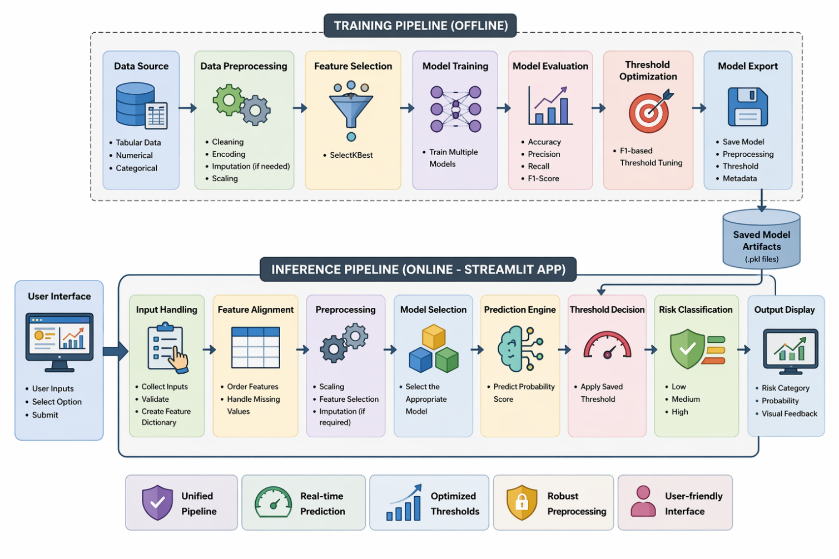
Proposed Solution & Architecture
8

Slide 9
Dataset & Tools/Technologies
Dataset Description
• Source: Kaggle
• Datasets Used:
Pima Indians Disease Dataset
UCI Disease Dataset
• Classes & Imbalance:
The dataset is imbalanced and is handled using threshold tuning and model evaluation techniques.
Data Representation:
Tabular dataset
no image data involved
Tools & Technologies
Language : Python 3.10+
Development Environment:
Vs Code
Jupyter Notebook
Data Processing:
NumPy
Pandas
Hardware Requirements:
Laptop (8 -16 GB RAM)
9

Slide 10
Progress in Implementation Plan & Methodology
Work Done So Far
Literature Survey Completed and identified gaps
Collected and analyzed diabetes and heart disease datasets from public sources
Performed data preprocessing:
Handling missing values
Encoding categorical features
Applied feature selection (SelectKBest)
Trained and Compared ML models: Logistic Regression, Random Forest
Evaluated using Accuracy, Precision, Recall, F1-score
10

Slide 11
Future Work Plan
Increase dataset size and diversity to improve model generalization
Apply advanced class imbalance handling techniques
Train and compare additional models such as SVM and XGBoost for performance improvement
Enhance UI with better input validation and visual risk representation
Extend the system to support additional diseases
Develop complete web application
11

Slide 12
References
[1] | V. Gupta, “Smart diagnosis: Machine learning for early detection of diabetes and heart disease,” International Journal for Research and Technologies in Innovation (IJRTI), vol. 10, no. 7, pp. 1–10, 2025.
[2] | P. Pandey and S. Gautam, “A study on the risk prediction of heart disease in diabetes patients using machine learning,” Journal of Medical Sciences, 2026.
[3] | Y. Kanda et al., “Machine learning models for prediction of HF and CKD development in early‑stage type 2 diabetes patients,” Scientific Reports, vol. 12, p. 24562, 2022.
[4] | Z. Zhang and L. Liu, “Risk of diabetes disease prediction using machine learning approach,” Healthcare Bulletin, 2026.
[5] | O. Ooko and G. Oginga, “Application of machine learning for early detection of chronic diseases in Africa,” Journal of Health Data Science, 2025.

Slide 13

13

